Slide 1
Chapter 6
TCP/IP

Slide 2
Outline
  6.1 Introduction
  6.2 the TCP/IP Layers
  6.3 Number Conversion
  6.4 IPv4 Addressing
  6.5 Subnet Masks
  6.6 CIDR Blocks
  6.7 Introduction to IPv6

Slide 3
Outline
  6.1 Introduction
  6.2 the TCP/IP Layers
  6.3 Number Conversion
  6.4 IPv4 Addressing
  6.5 Subnet Masks
  6.6 CIDR Blocks
  6.7 Introduction to IPv6

Slide 4
Outline
  6.1 Introduction
  6.2 the TCP/IP Layers
  6.3 Number Conversion
  6.4 IPv4 Addressing
  6.5 Subnet Masks
  6.6 CIDR Blocks
  6.7 Introduction to IPv6

Slide 5
Outline
  6.1 Introduction
  6.2 the TCP/IP Layers
  6.3 Number Conversion
  6.4 IPv4 Addressing
  6.5 Subnet Masks
  6.6 CIDR Blocks
  6.7 Introduction to IPv6

Slide 6
Outline
  6.1 Introduction
  6.2 the TCP/IP Layers
  6.3 Number Conversion
  6.4 IPv4 Addressing
  6.5 Subnet Masks
  6.6 CIDR Blocks
  6.7 Introduction to IPv6

Slide 7
Outline
  6.1 Introduction
  6.2 the TCP/IP Layers
  6.3 Number Conversion
  6.4 IPv4 Addressing
  6.5 Subnet Masks
  6.6 CIDR Blocks
  6.7 Introduction to IPv6

Slide 8
Outline
  6.1 Introduction
  6.2 the TCP/IP Layers
  6.3 Number Conversion
  6.4 IPv4 Addressing
  6.5 Subnet Masks
  6.6 CIDR Blocks
  6.7 Introduction to IPv6

Slide 9
Outline
  6.1 Introduction
  6.2 the TCP/IP Layers
  6.3 Number Conversion
  6.4 IPv4 Addressing
  6.5 Subnet Masks
  6.6 CIDR Blocks
  6.7 Introduction to IPv6

Slide 10
Objectives
Define how a TCP connection is established
Investigate the properties of the UDP connectionless protocol
Define the five classes of IP addresses
Investigate the properties of basic number conversion
Define the purpose of subnet masking

Slide 11
Objectives
Investigate the implementation of CIDR blocks and supernetting
Apply subnet masking concepts to allocate space for hosts in a subnet
Use a protocol analyzer to analyze TCP data packets
Define the address structure for IPv6
Analyze TCP data packets

Slide 12
Introduction
TCP/IP is the protocol suite used for communications between hosts in most local networks and on the Internet.
TCP/IP stands for the Transmission Control Protocol/Internet Protocol. TCP/IP is used for enabling network communications in LANs, campus networks, and wide area networks as long as the hosts support the TCP/IP protocol.
TCP/IP is widely supported and is included in operating systems such as Windows 9x, NT, Me, 2K and XP, Unix, and Linux.

Slide 13
Background
TCP/IP was developed by the Defense Advanced Research Projects Agency (DARPA) to provide a way to network the computers of government researchers together.
The DARPA funded initiative forced the use of a standard networking protocol by all defense contractors.
In 1978, the suite of protocols called TCP/IP was introduced. In 1983, TCP/IP replaced the Network Control Protocol (NCP) as the standard networking protocol used by the Advanced Research Projects Agency network (ARPAnet). ARPAnet is considered the predecessor to today’s INTERNET.

Slide 14
Chapter 6-2
the TCP/IP Layers

Slide 15
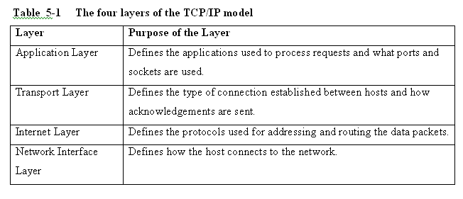
the TCP/IP Layers
The four layers of the TCP/IP model are listed in Table 6-1. The layers are
Application Internet
Transport Network Interface

Slide 16
the TCP/IP Layers
The TCP/IP protocol was established in 1978, prior to the final release of the OSI model (see Chapter 4) however, the four layers of the TCP/IP model do correlate to the seven layers of the OSI model as shown in the next slide (Fig. 6-1).

Slide 17
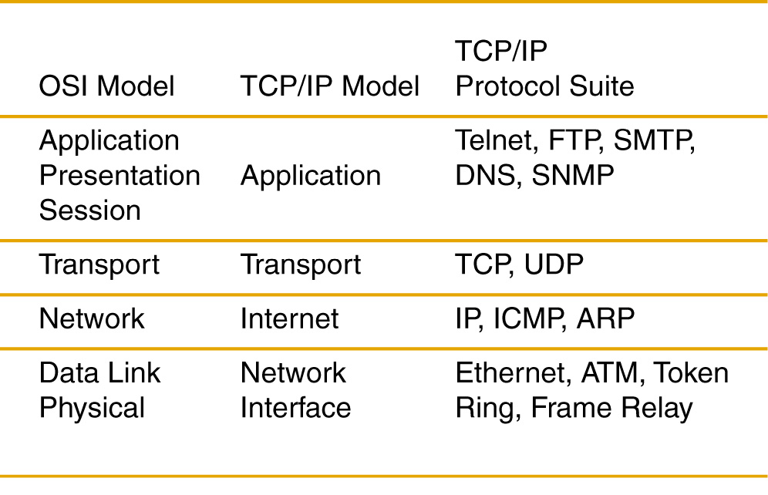

Slide 18
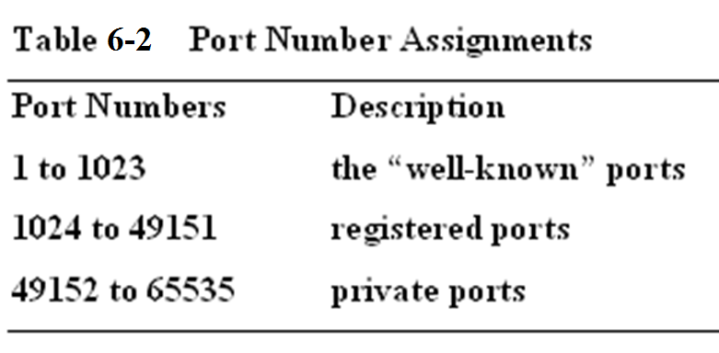
The Application layer of the TCP/IP stack is responsible for making sure a connection is made to an appropriate network port. These ports are reserved by ICANN (Internet Corporation for Assigned Names and Numbers).

Slide 19
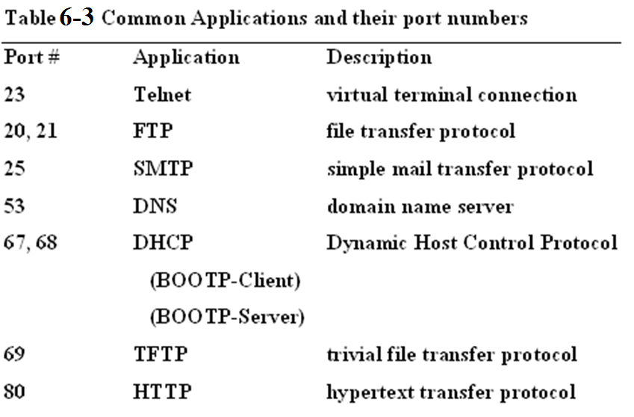

Slide 20
Transport Layer
The transport layer protocols in TCP/IP are very important in establishing a network connection, managing the delivery of data between a source and destination host, and terminating the data connection.
There are two transport protocols within the TCP/IP transport layer. These are TCP and UDP. The first protocol examined is TCP.
TCP, the Transport Control Protocol is a connection oriented protocol. A connection oriented protocol establishes the network connection, manages the data transfer, and terminates the connection.
The TCP protocol establishes a set of rules or guidelines for establishing the connection. TCP verifies the delivery of the data packets through the network and includes support for error checking and recovering lost data. TCP then specifies a procedure for terminating the network connection.

Slide 21
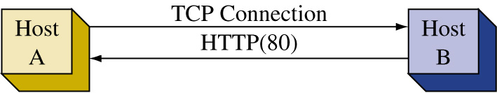
There is a unique sequence of three data packets exchanged at the beginning of a TCP connection between two hosts. A connection between two hosts is shown. This is a virtual connection that is made over the network. The first three packets always exchanged between two hosts when establishing a TCP connection are:
the SYN (Synchronizing) packet
the SYN + ACK (Synchronizing + Acknowledgement) packet
the ACK (Acknowledgement) packet

Slide 22
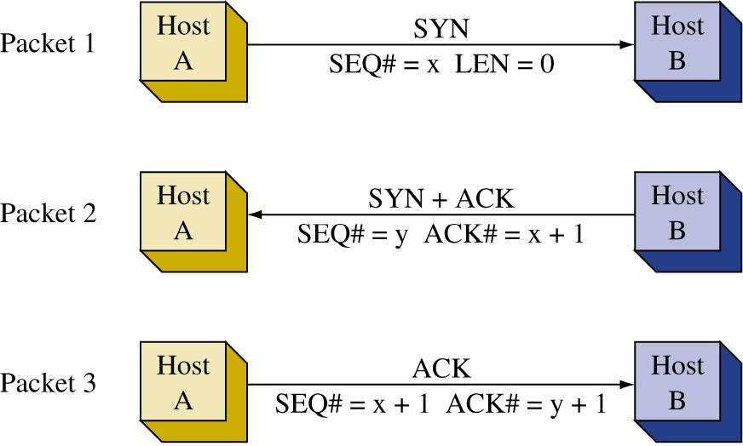
The three-packet initial TCP handshake

Slide 23
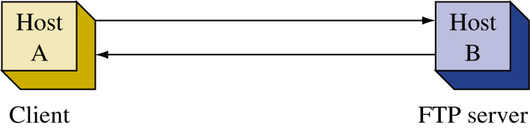
The following is a example of a TCP packet transmission captured using a protocol analyzer.
The network is set-up as shown. Host A (the client) is establishing an FTP connection with Host B. The captured file is 5-a.cap and is provided on the CD-ROM in the capture folder. Portions of the captured data packets are next shown.

Slide 24
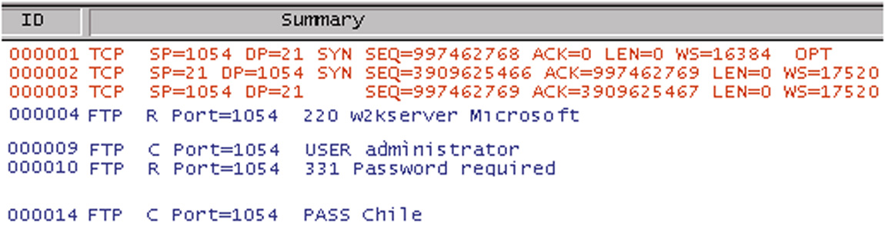
the three packets exchanged in the initial TCP handshake.
Packet 1 (ID 000001) is called the “SYN” or synchronizing packet. This packet is sent from the host computer on the network that wants to establish a TCP network connection. In this example, host A is making a TCP connection for an FTP file transfer. The summary information for packet 1 specifies that this is a TCP packet, the source port is 1054 (SP=1054), and the destination port is 21 (DP=21).

Slide 25
the three packets exchanged in the initial TCP handshake.
Packet 1 (ID 000001) is called the “SYN” or synchronizing packet. This packet is sent from the host computer on the network that wants to establish a TCP network connection. In this example, host A is making a TCP connection for an FTP file transfer. The summary information for packet 1 specifies that this is a TCP packet, the source port is 1054 (SP=1054), and the destination port is 21 (DP=21).

Slide 26
the three packets exchanged in the initial TCP handshake.
Packet 1 (ID 000001) is called the “SYN” or synchronizing packet. This packet is sent from the host computer on the network that wants to establish a TCP network connection. In this example, host A is making a TCP connection for an FTP file transfer. The summary information for packet 1 specifies that this is a TCP packet, the source port is 1054 (SP=1054), and the destination port is 21 (DP=21).

Slide 27
the three packets exchanged in the initial TCP handshake.
Packet 1 (ID 000001) is called the “SYN” or synchronizing packet. This packet is sent from the host computer on the network that wants to establish a TCP network connection. In this example, host A is making a TCP connection for an FTP file transfer. The summary information for packet 1 specifies that this is a TCP packet, the source port is 1054 (SP=1054), and the destination port is 21 (DP=21).

Slide 28
the three packets exchanged in the initial TCP handshake.
Packet 1 (ID 000001) is called the “SYN” or synchronizing packet. This packet is sent from the host computer on the network that wants to establish a TCP network connection. In this example, host A is making a TCP connection for an FTP file transfer. The summary information for packet 1 specifies that this is a TCP packet, the source port is 1054 (SP=1054), and the destination port is 21 (DP=21).

Slide 29
the three packets exchanged in the initial TCP handshake.
Packet 1 (ID 000001) is called the “SYN” or synchronizing packet. This packet is sent from the host computer on the network that wants to establish a TCP network connection. In this example, host A is making a TCP connection for an FTP file transfer. The summary information for packet 1 specifies that this is a TCP packet, the source port is 1054 (SP=1054), and the destination port is 21 (DP=21).

Slide 30
the three packets exchanged in the initial TCP handshake.
Port 1054 is an arbitrary port number that the FTP client picks or is assigned by the operating system. The destination port 21 is the well-known FTP (see. Table 6-3). The packet has a starting sequence number SEQ=997462768, and there is no acknowledgement (ACK=0). The length of the data packet is 0 (LEN=0). This indicates that the packet does not contain any data. The window size = 16384 (WS=16384). The window size indicates how many data packets can be transferred without an acknowledgement.

Slide 31
the three packets exchanged in the initial TCP handshake.
Port 1054 is an arbitrary port number that the FTP client picks or is assigned by the operating system. The destination port 21 is the well-known FTP (see. Table 6-3). The packet has a starting sequence number SEQ=997462768, and there is no acknowledgement (ACK=0). The length of the data packet is 0 (LEN=0). This indicates that the packet does not contain any data. The window size = 16384 (WS=16384). The window size indicates how many data packets can be transferred without an acknowledgement.

Slide 32
the three packets exchanged in the initial TCP handshake.
Port 1054 is an arbitrary port number that the FTP client picks or is assigned by the operating system. The destination port 21 is the well-known FTP (see. Table 6-3). The packet has a starting sequence number SEQ=997462768, and there is no acknowledgement (ACK=0). The length of the data packet is 0 (LEN=0). This indicates that the packet does not contain any data. The window size = 16384 (WS=16384). The window size indicates how many data packets can be transferred without an acknowledgement.

Slide 33
the three packets exchanged in the initial TCP handshake.
Port 1054 is an arbitrary port number that the FTP client picks or is assigned by the operating system. The destination port 21 is the well-known FTP (see. Table 6-3). The packet has a starting sequence number SEQ=997462768, and there is no acknowledgement (ACK=0). The length of the data packet is 0 (LEN=0). This indicates that the packet does not contain any data. The window size = 16384 (WS=16384). The window size indicates how many data packets can be transferred without an acknowledgement.

Slide 34
the three packets exchanged in the initial TCP handshake.
Port 1054 is an arbitrary port number that the FTP client picks or is assigned by the operating system. The destination port 21 is the well-known FTP (see. Table 6-3). The packet has a starting sequence number SEQ=997462768, and there is no acknowledgement (ACK=0). The length of the data packet is 0 (LEN=0). This indicates that the packet does not contain any data. The window size = 16384 (WS=16384). The window size indicates how many data packets can be transferred without an acknowledgement.

Slide 35
the three packets exchanged in the initial TCP handshake.
Packet 2 is the “SYN-ACK” packet from the FTP server. The sequence number SEQ = 3909625466 is the start of a new sequence number for the data packet transfers from host B. The source port is 21 (SP=21) and the destination port for packet 2 is 1054 (DP=1054). ACK=997462769 is an acknowledge by host B (the FTP server) that the first TCP transmission was received. Note that this acknowledgement shows an increment of one from the starting sequence number provided by host A in packet 1.

Slide 36
the three packets exchanged in the initial TCP handshake.
Packet 2 is the “SYN-ACK” packet from the FTP server. The sequence number SEQ = 3909625466 is the start of a new sequence number for the data packet transfers from host B. The source port is 21 (SP=21) and the destination port for packet 2 is 1054 (DP=1054). ACK=997462769 is an acknowledge by host B (the FTP server) that the first TCP transmission was received. Note that this acknowledgement shows an increment of one from the starting sequence number provided by host A in packet 1.

Slide 37
the three packets exchanged in the initial TCP handshake.
Packet 2 is the “SYN-ACK” packet from the FTP server. The sequence number SEQ = 3909625466 is the start of a new sequence number for the data packet transfers from host B. The source port is 21 (SP=21) and the destination port for packet 2 is 1054 (DP=1054). ACK=997462769 is an acknowledge by host B (the FTP server) that the first TCP transmission was received. Note that this acknowledgement shows an increment of one from the starting sequence number provided by host A in packet 1.

Slide 38
the three packets exchanged in the initial TCP handshake.
Packet 2 is the “SYN-ACK” packet from the FTP server. The sequence number SEQ = 3909625466 is the start of a new sequence number for the data packet transfers from host B. The source port is 21 (SP=21) and the destination port for packet 2 is 1054 (DP=1054). ACK=997462769 is an acknowledge by host B (the FTP server) that the first TCP transmission was received. Note that this acknowledgement shows an increment of one from the starting sequence number provided by host A in packet 1.

Slide 39
the three packets exchanged in the initial TCP handshake.
Packet 2 is the “SYN-ACK” packet from the FTP server. The sequence number SEQ = 3909625466 is the start of a new sequence number for the data packet transfers from host B. The source port is 21 (SP=21) and the destination port for packet 2 is 1054 (DP=1054). ACK=997462769 is an acknowledge by host B (the FTP server) that the first TCP transmission was received. Note that this acknowledgement shows an increment of one from the starting sequence number provided by host A in packet 1.

Slide 40
the three packets exchanged in the initial TCP handshake.
Packet 2 is the “SYN-ACK” packet from the FTP server. The sequence number SEQ = 3909625466 is the start of a new sequence number for the data packet transfers from host B. The source port is 21 (SP=21) and the destination port for packet 2 is 1054 (DP=1054). ACK=997462769 is an acknowledge by host B (the FTP server) that the first TCP transmission was received. Note that this acknowledgement shows an increment of one from the starting sequence number provided by host A in packet 1.

Slide 41
the three packets exchanged in the initial TCP handshake.
Packet 2 is the “SYN-ACK” packet from the FTP server. The sequence number SEQ = 3909625466 is the start of a new sequence number for the data packet transfers from host B. The source port is 21 (SP=21) and the destination port for packet 2 is 1054 (DP=1054). ACK=997462769 is an acknowledge by host B (the FTP server) that the first TCP transmission was received. Note that this acknowledgement shows an increment of one from the starting sequence number provided by host A in packet 1.

Slide 42
the three packets exchanged in the initial TCP handshake.
Packet 3 is an acknowledgement from the client (host A) back to the FTP server (host B) that packet 2 was received. Note the acknowledgement is ACK= 3909625467 which is an increment of one from the SEQ number transmitted is packet 2. This completes the initial handshake establishing the TCP connection. The next part is the data packet transfer. At this point, the two hosts can begin transferring data packets.

Slide 43
the three packets exchanged in the initial TCP handshake.
Packet 3 is an acknowledgement from the client (host A) back to the FTP server (host B) that packet 2 was received. Note the acknowledgement is ACK= 3909625467 which is an increment of one from the SEQ number transmitted is packet 2. This completes the initial handshake establishing the TCP connection. The next part is the data packet transfer. At this point, the two hosts can begin transferring data packets.

Slide 44
the three packets exchanged in the initial TCP handshake.
Packet 3 is an acknowledgement from the client (host A) back to the FTP server (host B) that packet 2 was received. Note the acknowledgement is ACK= 3909625467 which is an increment of one from the SEQ number transmitted is packet 2. This completes the initial handshake establishing the TCP connection. The next part is the data packet transfer. At this point, the two hosts can begin transferring data packets.

Slide 45
the three packets exchanged in the initial TCP handshake.
Packet 3 is an acknowledgement from the client (host A) back to the FTP server (host B) that packet 2 was received. Note the acknowledgement is ACK= 3909625467 which is an increment of one from the SEQ number transmitted is packet 2. This completes the initial handshake establishing the TCP connection. The next part is the data packet transfer. At this point, the two hosts can begin transferring data packets.

Slide 46
the three packets exchanged in the initial TCP handshake.
Packet 3 is an acknowledgement from the client (host A) back to the FTP server (host B) that packet 2 was received. Note the acknowledgement is ACK= 3909625467 which is an increment of one from the SEQ number transmitted is packet 2. This completes the initial handshake establishing the TCP connection. The next part is the data packet transfer. At this point, the two hosts can begin transferring data packets.

Slide 47
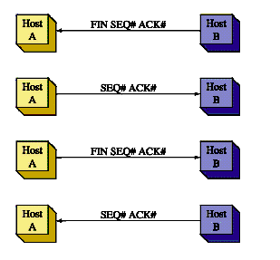
Terminating the TCP Session
The last part of the TCP connection is terminating the session for each host.
The first thing that happens is a host sends a FIN (finish) packet to the other connected host.
Host B sends a FIN packet to Host A indicating the data transmission is complete.
Host A responds with an ACK packet acknowledging the reception of the FIN packet.
Host A then sends Host B a FIN packet indicating that the connection is being terminated.
Host B replies with an ACK packet.

Slide 48
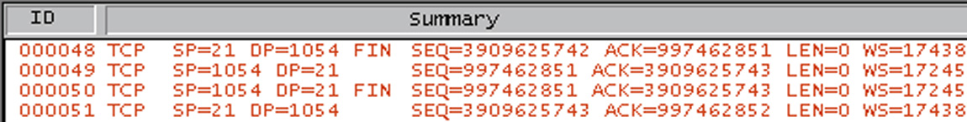
An example of the four-packet TCP connection termination.
Packet 48 is a TCP packet with a source port of 21 (SP=21) and a destination port of 1054 (DP= 1054). The FIN statement is shown followed by a SEQ# and an ACK#. Remember, the SEQ and ACK numbers are used to keep track of the number of packets transmitted and an acknowledgement of the number received. The LEN of packet 48 is 0 which means the packet does not contain any data.

Slide 49
An example of the four-packet TCP connection termination.
Packet 48 is a TCP packet with a source port of 21 (SP=21) and a destination port of 1054 (DP= 1054). The FIN statement is shown followed by a SEQ# and an ACK#. Remember, the SEQ and ACK numbers are used to keep track of the number of packets transmitted and an acknowledgement of the number received. The LEN of packet 48 is 0 which means the packet does not contain any data.

Slide 50
An example of the four-packet TCP connection termination.
Packet 48 (Fig. 6-7) is a TCP packet with a source port of 21 (SP=21) and a destination port of 1054 (DP= 1054). The FIN statement is shown followed by a SEQ# and an ACK#. Remember, the SEQ and ACK numbers are used to keep track of the number of packets transmitted and an acknowledgement of the number received. The LEN of packet 48 is 0 which means the packet does not contain any data.

Slide 51
An example of the four-packet TCP connection termination.
Packet 48 (Fig. 6-7) is a TCP packet with a source port of 21 (SP=21) and a destination port of 1054 (DP= 1054). The FIN statement is shown followed by a SEQ# and an ACK#. Remember, the SEQ and ACK numbers are used to keep track of the number of packets transmitted and an acknowledgement of the number received. The LEN of packet 48 is 0 which means the packet does not contain any data.

Slide 52
An example of the four-packet TCP connection termination.
Packet 48 (Fig. 6-7) is a TCP packet with a source port of 21 (SP=21) and a destination port of 1054 (DP= 1054). The FIN statement is shown followed by a SEQ# and an ACK#. Remember, the SEQ and ACK numbers are used to keep track of the number of packets transmitted and an acknowledgement of the number received. The LEN of packet 48 is 0 which means the packet does not contain any data.

Slide 53
An example of the four-packet TCP connection termination.
Packet 48 (Fig. 6-7) is a TCP packet with a source port of 21 (SP=21) and a destination port of 1054 (DP= 1054). The FIN statement is shown followed by a SEQ# and an ACK#. Remember, the SEQ and ACK numbers are used to keep track of the number of packets transmitted and an acknowledgement of the number received. The LEN of packet 48 is 0 which means the packet does not contain any data.

Slide 54
An example of the four-packet TCP connection termination.
Packet 49 is an acknowledgement from the host, at port 1054, of the FIN packet. Remember the FIN packet was sent by the Host at the source port 21. In packet 50 the Host at port 1054 sends a FIN packet to the host at the destination port of 21. In packet 51, the host at port 21 acknowledges the reception of the FIN packet and the four packet sequence closes the TCP connection.

Slide 55
An example of the four-packet TCP connection termination.
Packet 49 is an acknowledgement from the host, at port 1054, of the FIN packet. Remember the FIN packet was sent by the Host at the source port 21. In packet 50 the Host at port 1054 sends a FIN packet to the host at the destination port of 21. In packet 51, the host at port 21 acknowledges the reception of the FIN packet and the four packet sequence closes the TCP connection.

Slide 56
An example of the four-packet TCP connection termination.
Packet 49 is an acknowledgement from the host, at port 1054, of the FIN packet. Remember the FIN packet was sent by the Host at the source port 21. In packet 50 the Host at port 1054 sends a FIN packet to the host at the destination port of 21. In packet 51, the host at port 21 acknowledges the reception of the FIN packet and the four packet sequence closes the TCP connection.

Slide 57
An example of the four-packet TCP connection termination.
Packet 49 is an acknowledgement from the host, at port 1054, of the FIN packet. Remember the FIN packet was sent by the Host at the source port 21. In packet 50 the Host at port 1054 sends a FIN packet to the host at the destination port of 21. In packet 51, the host at port 21 acknowledges the reception of the FIN packet and the four packet sequence closes the TCP connection.

Slide 58
An example of the four-packet TCP connection termination.
Packet 49 is an acknowledgement from the host, at port 1054, of the FIN packet. Remember the FIN packet was sent by the Host at the source port 21. In packet 50 the Host at port 1054 sends a FIN packet to the host at the destination port of 21. In packet 51, the host at port 21 acknowledges the reception of the FIN packet and the four packet sequence closes the TCP connection.

Slide 59
An example of the four-packet TCP connection termination.
Packet 49 is an acknowledgement from the host, at port 1054, of the FIN packet. Remember the FIN packet was sent by the Host at the source port 21. In packet 50 the Host at port 1054 sends a FIN packet to the host at the destination port of 21. In packet 51, the host at port 21 acknowledges the reception of the FIN packet and the four packet sequence closes the TCP connection.

Slide 60
UDP
UDP, the User Datagram Protocol is a connectionless protocol. This means that UDP packets are transported over the network without a connection being established and without any acknowledgement that the data packets arrived at the destination. UDP is useful in applications such as videoconferencing and audio feeds where acknowledgements that the data packet arrived are not necessary.

Slide 61
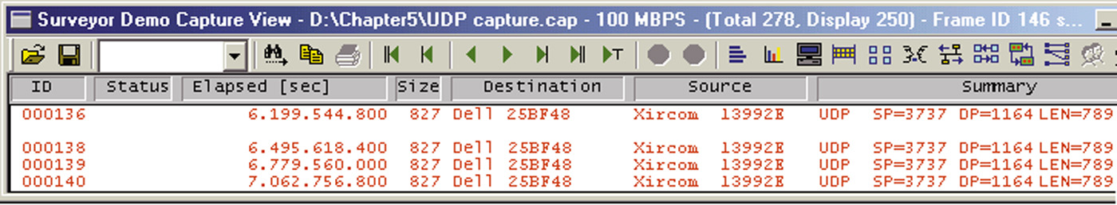
A UDP packet transfer
Packet 136 is the start of a UDP packet transfer of an Internet audio feed. A TCP connection to the Internet was first made and then the music feed was started. At that time, the UDP connectionless packets started.

Slide 62
A UDP packet transfer
Packet 136 is the start of a UDP packet transfer of an Internet audio feed. A TCP connection to the Internet was first made and then the music feed was started. At that time, the UDP connectionless packets started.

Slide 63
A UDP packet transfer
Packets 138, 139, and 140 are the same type of packets with a length of 789. There are no acknowledgements sent back from the client. All of the packets are coming from the Internet source. UDP does not have a procedure for terminating the data transfer, the source either stops delivery of the data packets or the client terminates the connection.

Slide 64
A UDP packet transfer
Packets 138, 139, and 140 are the same type of packets with a length of 789. There are no acknowledgements sent back from the client. All of the packets are coming from the Internet source. UDP does not have a procedure for terminating the data transfer, the source either stops delivery of the data packets or the client terminates the connection.

Slide 65
A UDP packet transfer
Packets 138, 139, and 140 are the same type of packets with a length of 789. There are no acknowledgements sent back from the client. All of the packets are coming from the Internet source. UDP does not have a procedure for terminating the data transfer, the source either stops delivery of the data packets or the client terminates the connection.

Slide 66
The Internet Layer
The TCP/IP Internet Layer defines the protocols used for address and routing the data packets. Protocols that are part of the TCP/IP Internet layer include IP, ARP, ICMP, and IGMP.

Slide 67
IP (Internet Protocol)
IP, the Internet Protocol, defines the addressing used for identifying the source and destination addresses of data packets being delivered over an IP network.
The IP address is a logical address that consists of a network and a host address portion. The network portion is used to direct the data to the proper network.
The host address identifies the address locally assigned to the host. The network portion of the address is similar to the area code for a telephone number. The host address in similar to the local exchange number. The network and host portions of the IP address are then used to route the data packets to the destination.

Slide 68
ARP (Address Resolution Protocol)
ARP, the Address Resolution Protocol, is used to resolve an IP address to a hardware address for final delivery of data packets to the destination.
ARP issues a query in a network called an ARP request, asking which network interface has this IP address. The host assigned the IP address replies with an ARP reply that contains the hardware address for the destination host.

Slide 69
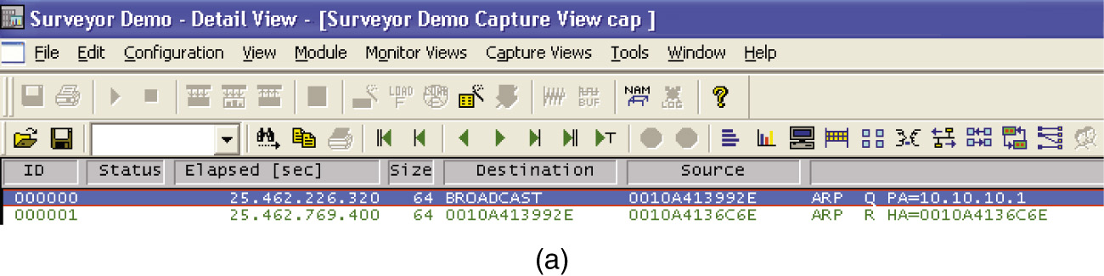
As shown highlighted in blue, an ARP request is issued on the LAN. The source MAC address of the packet is
00-10-A4-13-99-2E. The destination address on the local area network shown is BROADCAST which means that this message is being sent to all computers in the local area network. A query (Q) is being asked who has the IP address 10.10.10.1 (PA= ). PA is an abbreviation for Protocol Address.

Slide 70
As shown highlighted in blue, an ARP request is issued on the LAN. The source MAC address of the packet is
00-10-A4-13-99-2E. The destination address on the local area network shown is BROADCAST which means that this message is being sent to all computers in the local area network. A query (Q) is being asked who has the IP address 10.10.10.1 (PA= ). PA is an abbreviation for Protocol Address.

Slide 71
As shown highlighted in blue, an ARP request is issued on the LAN. The source MAC address of the packet is
00-10-A4-13-99-2E. The destination address on the local area network shown is BROADCAST which means that this message is being sent to all computers in the local area network. A query (Q) is being asked who has the IP address 10.10.10.1 (PA= ). PA is an abbreviation for Protocol Address.

Slide 72
As shown highlighted in blue, an ARP request is issued on the LAN. The source MAC address of the packet is
00-10-A4-13-99-2E. The destination address on the local area network shown is BROADCAST which means that this message is being sent to all computers in the local area network. A query (Q) is being asked who has the IP address 10.10.10.1 (PA= ). PA is an abbreviation for Protocol Address.

Slide 73
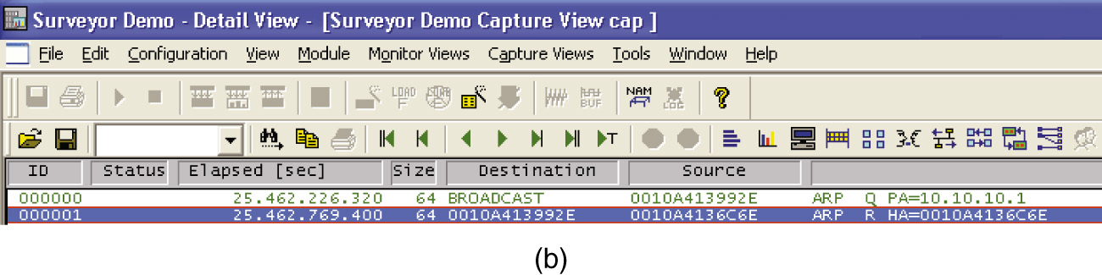
The highlighted blue area now shows the destination computer replying with its MAC address back to the source that issued the ARP request. This is called an ARP reply which is a protocol where the MAC address is returned. The R after the ARP indicates this is an ARP reply. The source of the ARP reply is from 00-10-A4-13-6C-6E which is replying that the MAC address for 10.10.10.1 is 00-10-A4-13-6C-6E (HA=). In this case, the owner of the IP address replied to the message but this is not always the case. In some cases another networking device such as a router can provide the MAC address information. In that case, the MAC address being returned is for the next networking device in the route to the destination.

Slide 74
The highlighted blue area now shows the destination computer replying with its MAC address back to the source that issued the ARP request. This is called an ARP reply which is a protocol where the MAC address is returned. The R after the ARP indicates this is an ARP reply. The source of the ARP reply is from 00-10-A4-13-6C-6E which is replying that the MAC address for 10.10.10.1 is 00-10-A4-13-6C-6E (HA=). In this case, the owner of the IP address replied to the message but this is not always the case. In some cases another networking device such as a router can provide the MAC address information. In that case, the MAC address being returned is for the next networking device in the route to the destination.

Slide 75
The highlighted blue area now shows the destination computer replying with its MAC address back to the source that issued the ARP request. This is called an ARP reply which is a protocol where the MAC address is returned. The R after the ARP indicates this is an ARP reply. The source of the ARP reply is from 00-10-A4-13-6C-6E which is replying that the MAC address for 10.10.10.1 is 00-10-A4-13-6C-6E (HA=). In this case, the owner of the IP address replied to the message but this is not always the case. In some cases another networking device such as a router can provide the MAC address information. In that case, the MAC address being returned is for the next networking device in the route to the destination.

Slide 76
The highlighted blue area now shows the destination computer replying with its MAC address back to the source that issued the ARP request. This is called an ARP reply which is a protocol where the MAC address is returned. The R after the ARP indicates this is an ARP reply. The source of the ARP reply is from 00-10-A4-13-6C-6E which is replying that the MAC address for 10.10.10.1 is 00-10-A4-13-6C-6E (HA=). In this case, the owner of the IP address replied to the message but this is not always the case. In some cases another networking device such as a router can provide the MAC address information. In that case, the MAC address being returned is for the next networking device in the route to the destination.

Slide 77
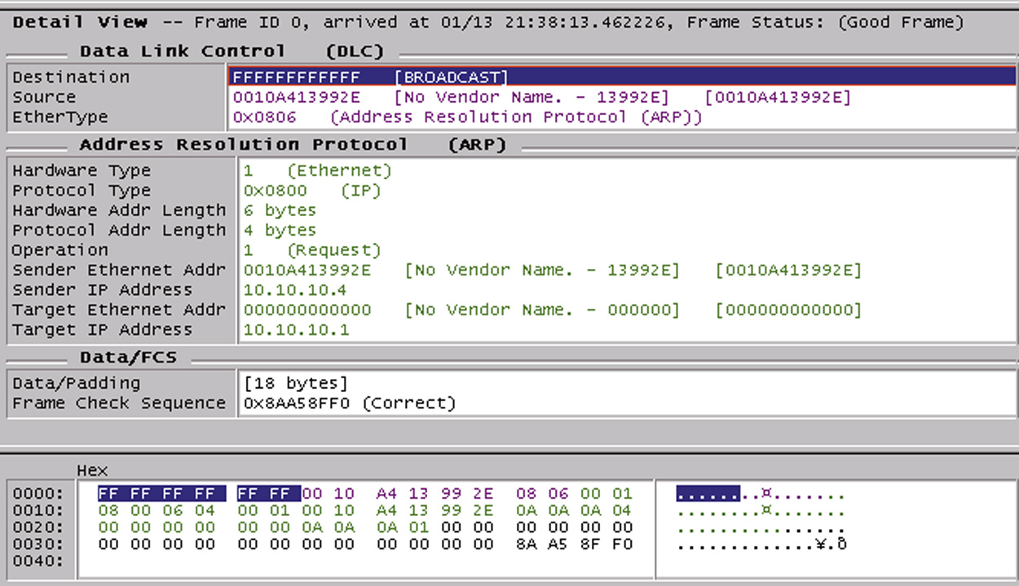
the packet details of the ARP request

Slide 78
ICMP Protocol
ICMP, the Internet Control Message Protocol is used to control the flow of data in the network , reporting errors, and for performing diagnostics. A networking device, such as a router, sends an ICMP source-quench packet to a host that requests a slowdown in the data transfer.
A very important troubleshooting tool within the ICMP protocol is PING, the Packet InterNet Groper. The ping command is used to verify connectivity with another host in the network. The destination host could be in a LAN, a campus LAN, or on the Internet.

Slide 79
IGMP Protocol
IGMP is the Internet Group Message Protocol. IGMP is used when one host needs to send data to many destination hosts. This is called multicasting.
The addresses used to send a multicast data packet are called multicast addresses. These are reserved addresses that are not assigned to hosts in a network.
An example of an application that uses IGMP packets is when a router uses multicasting to share routing tables. This is explained in Chapter 7 when routing protocols are examined.

Slide 80
IGMP Protocol
Another application to use IGMP packets is when a hosts wants to stream data to multiple hosts.
Streaming means the data are sent without waiting for any acknowledgement that the data packets were delivered. In fact, in the IGMP protocol, the source doesn’t care if the destination receives a packet.
Streaming is an important application in the transfer of audio and video files over the Internet. Another feature of IGMP is the data is handed off to the application layer as it arrives. This enables to begin processing the data for playback.

Slide 81
The Network Interface Layer
The Network Interface Layer of the TCP/IP model defines how the host connects to the network. The host could be a computer connected to an Ethernet or Token-Ring network or a router connected to a frame-relay wide area network.
TCP/IP is not dependent on a specific networking technology therefore, TCP/IP can be adapted to run on newer networking technologies such as ATM (Asynchronous Transfer Mode).

Slide 82
Section 6-2 Key Terms
Well-known ports
ICANN
Transport Layer Protocols
TCP
Connection Oriented Protocol
SYN
SYN + ACK
ACK

Slide 83
Section 6-2 Key Terms
UDP
Internet Layer
IP (internet protocol)
ARP
IGMP
Multicasting
Multicast Address
Network Interface Layer

Slide 84
Chapter 6-3
Number Conversion

Slide 85
Binary – Decimal Conversion
Binary numbers are represented as a logical 0 or logical 1 in base 2 format. This means that each number has a place value of 2^{n} where n is the place value position of the binary digit.
The place value start at 2⁰ with the LSB (least significant bit position). For example the binary number 1 0 1 1 has the place values of 2⁰ the LSB position to 2³ for the MSB position.

Slide 86
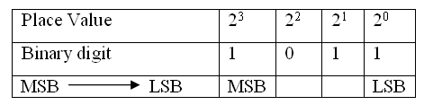
Place Value
1 0 1 1 = 1 x 2³ + 0 x 2² + 1 x 2¹ + 1 x 2⁰
= 11

Slide 87
Example 6-1
Example 6-1
Problem: Given a 32-bit IP address number expressed in binary format, convert the number to a dotted-decimal format.
1 1 0 0 0 0 0 0 1 0 1 0 1 0 0 0 0 0 1 0 0 0 0 0 0 0 0 0 1 1 0 0
octet – 4 octet – 3 octet - 2 octet – 1
Pause the player and resume play when you have an answer.

Slide 88
Example 6-1 Solution
the dotted decimal equivalent is
192.168.32.12

Slide 89
Decimal to binary
The steps for converting decimal numbers to binary
Divide the decimal number by 2, record the remainder of 0 or 1 and write the quotient or result of the division by 2.
Divide the quotient by 2 and record the remainder of 0 or 1. Write the quotient and repeat this step until the quotient is 0.
Write the remainder numbers (0 and 1) in reverse order to obtain the binary equivalent value.

Slide 90
Example 6-2
Convert the decimal number, 12, to binary.

Slide 91
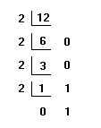
Example 6-2 - Solution
The answer is 1 1 0 0

Slide 92
Example 6-3
Convert 33 to its binary equivalent.

Slide 93
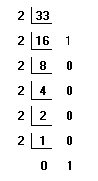
Example 6-3 - Solution
The answer is 1 0 0 0 0 1

Slide 94
Example 6-4
Convert the decimal number 254 to binary.

Slide 95
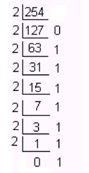
Example 6-4 - Solution

Slide 96
Hexadecimal Numbers
Hexadecimal numbers (HEX) are Base16 numbers. The numbering systems for hexadecimal is provided in Table 5-5 in the text.
It takes four binary numbers to represent a hexadecimal number. Notice that the letters A – F are used to represent the decimal numbers 10 to 15.
The simplest way to convert hexadecimal numbers to binary is through the use of either a calculator or a look up table such as Table 6-5.

Slide 97
Table 6-5 Hexadecimal conversion table
Decimal | Hexadecimal | Binary
0 | 0 | 0 0 0 0
1 | 1 | 0 0 0 1
2 | 2 | 0 0 1 0
3 | 3 | 0 0 1 1
4 | 4 | 0 1 0 0
5 | 5 | 0 1 0 1
6 | 6 | 0 1 1 0
7 | 7 | 0 1 1 1
8 | 8 | 1 0 0 0
9 | 9 | 1 0 0 1
10 | A | 1 0 1 0
11 | B | 1 0 1 1
12 | C | 1 1 0 0
13 | D | 1 1 0 1
14 | E | 1 1 1 0
15 | F | 1 1 1 1

Slide 98
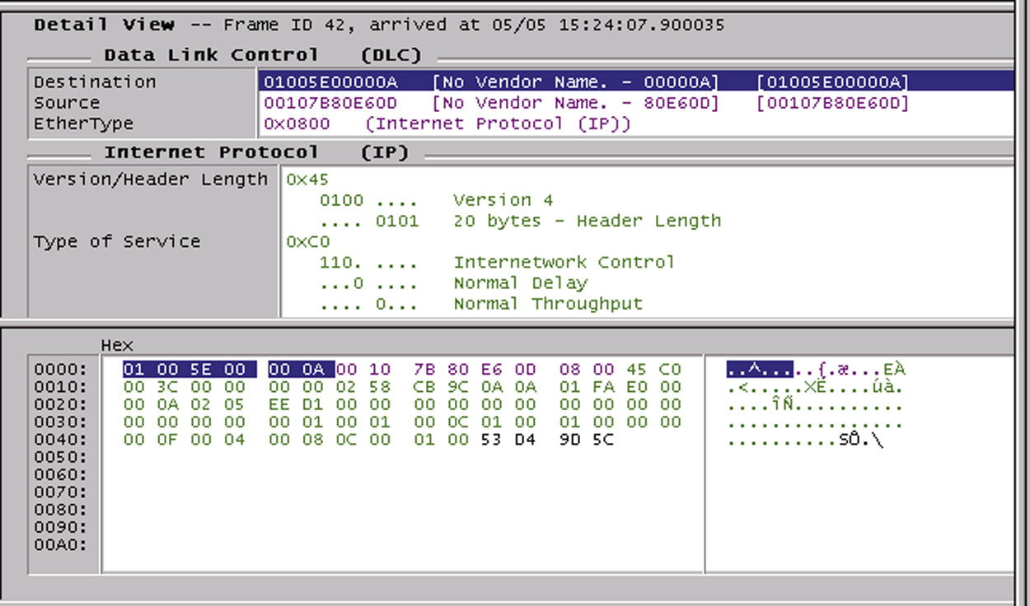
Hexadecimal numbers are used in computer networks to represent the computer’s 12-hex character MAC address and the hex numbers are used to display the packet details in a protocol analyzer as shown.

Slide 99
Hexadecimal numbers are used in computer networks to represent the computer’s 12-hex character MAC address and the hex numbers are used to display the packet details in a protocol analyzer as shown.

Slide 100
Notice the EtherType number is 0x0800 which is defining that this an IP (Internet Protocol) packet. Also note that the numbers at the bottom of the screen are expressed in Hex (hexadecimal) format. These numbers are the values in the data packets.

Slide 101
Notice the EtherType number is 0x0800 which is defining that this an IP (Internet Protocol) packet. Also note that the numbers at the bottom of the screen are expressed in Hex (hexadecimal) format. These numbers are the values in the data packets.

Slide 102
Example 6-5
Convert the following hexadecimal number to binary. 0x48AF

Slide 103
Example 6-5 - Solution
Solution: Use table 6-5 to convert the hex numbers.
Hex: 4 8 A F
Binary: 0 1 0 0 1 0 0 0 1 0 1 0 1 1 1 1

Slide 104
Example 6-6
Convert the following hexadecimal number to binary.
0x0800

Slide 105
Example 6-6 - Solution
Solution: Use table 6-5 to convert the hex numbers.
Hex: 0 8 0 0
Binary: 0 0 0 0 1 0 0 0 0 0 0 0 0 0 0 0

Slide 106
Example 6-7
Convert the following binary number to hexadecimal,
0 1 0 0 1 1 0 0 1 0 1 0

Slide 107
Example 6-7 - Solution
Solution:
Separate the binary numbers into groups of four beginning with the least significant bit position. Next use the lookup table (Table 5-5) to convert each 4-bit binary group to hexadecimal.
0 1 0 1 1 1 0 0 1 0 1 0
4 C A
The answer is 0x4CA.

Slide 108
Section 6-3 Key Terms
Hex

Slide 109
Chapter 6-4
IPv4 Addressing

Slide 110
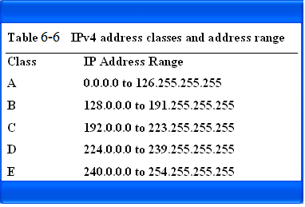
The IPv4 classes and address range

Slide 111
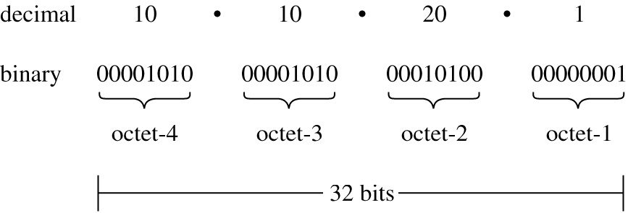
The structure of the 32-bit IPv4 address

Slide 112
Decimal 10 10 20 1
Binary 00001010 00001010 00010100 00000001
Fig. 6-12 The structure of the 32-bit IP address.

Slide 113
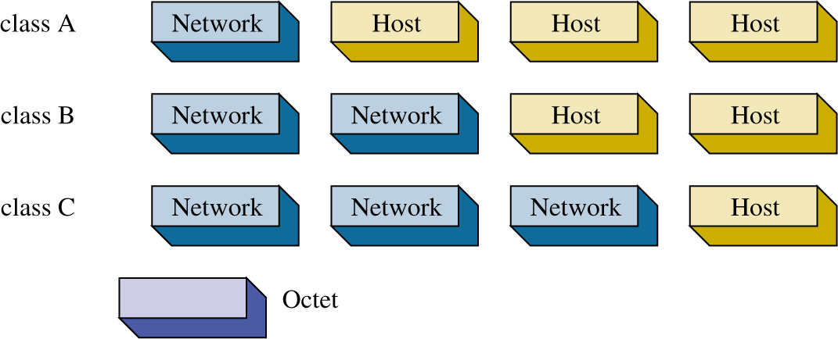
The octets making up the network and host portions of the IPv4 address for classes A, B, and C.

Slide 114
Table 6-8 The breakdown of the network and host bits by class.
Class Network Bits Host Bits
A 8 24
B 16 16
C 24 8

Slide 115
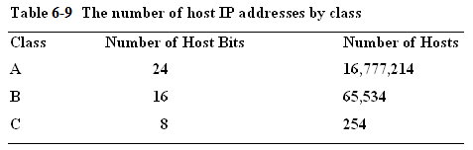

Slide 116
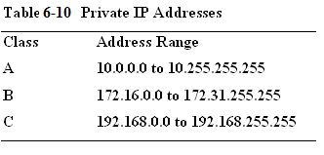
Address ranges in class A,B, and C have been set aside for private use. These addresses, called private addresses, are not used for Internet data traffic but are intended to be used specifically on internal networks called Intranets.

Slide 117
Functionally, private addresses work the same as public addresses except private addresses are not routed on the Internet. These are called non-routable IP address and are block by the Internet Service Providers.

Slide 118
ARIN
IP addresses are assigned by ARIN, the American Registry for Internet Numbers. www.arin.net
ARIN assigns IP address space to Internet Service Provides (ISP) and end users. ARIN only assigns IP address space to ISPs and end users if they qualify.
This requires that the ISP or end user be large enough to merit a block of addresses. In the case where blocks of addresses are allocated by ARIN to the ISPs, the ISPs issue addresses to their customers.
For example, a Telco could be the ISP that has a large block of IP addresses and issues an IP address to a user. A local ISP could also be assigned a block of IP addresses from ARIN, but the local ISP must have a large number of users.

Slide 119
ARIN
ARIN also assigns end users IP addresses. Once again, the end user must qualify to receive a block of addresses from ARIN. This usually means that the end user must be large.
For example, many universities and large businesses can receive a block of IP addresses from ARIN. However, most end users will get their IP addresses from an ISP (e.g. Telco) or have IP addresses assigned dynamically when they connect to the ISP.

Slide 120
Section 6-4 Key Terms
IPv4
Class A, B, C, D, and E
Non-routable IP Addresses
ARIN

Slide 121
Chapter 6-5
Subnet Masks

Slide 122
Subnetting
Subnetting is a technique used to break down (or partition) networks into subnets. The subnets are created through the use of subnet masks.
The subnet mask identifies what bits in the IP address are to be used to represent the network/subnet portion of an IP address.

Slide 124
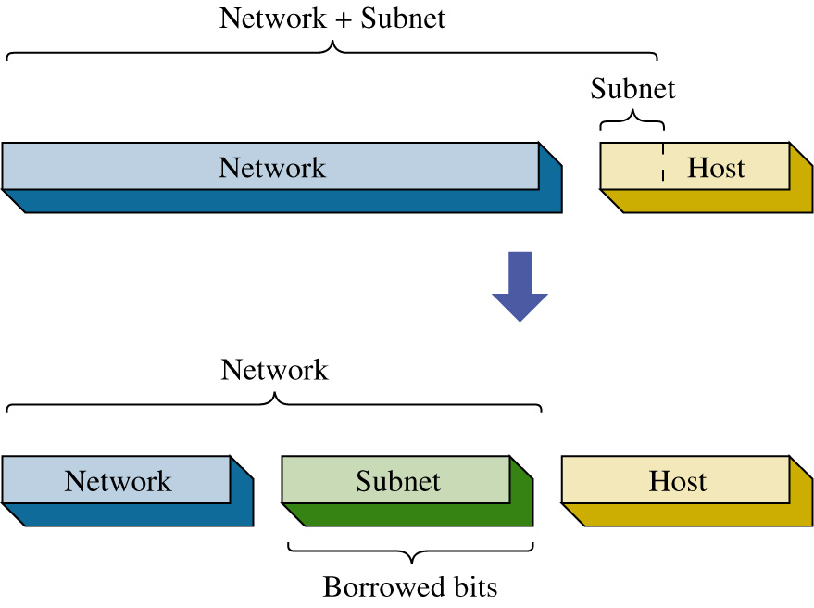
The subnets are created by borrowing bits from the host portion of the IP address as shown.
The network portion of the IP address and the new subnet bits are used to define the new subnet. Routers use this information to properly forward data packets to the proper subnet.

Slide 125
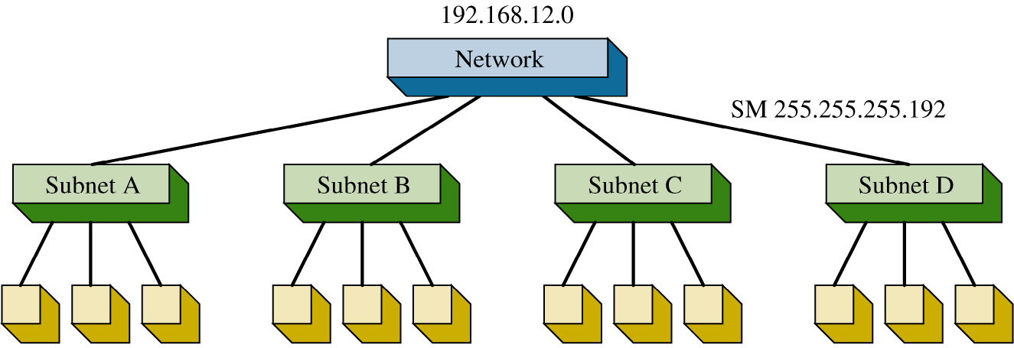
The Class C network, shown is partitioned into four subnets. It takes 2 bits to provide four possible subnets therefore 2-bits are borrowed from the host bits.
This means the process of creating the four subnets reduces the number of bits available for host IP addresses.

Slide 126
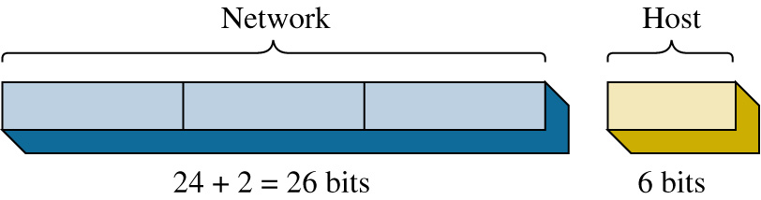

Slide 127
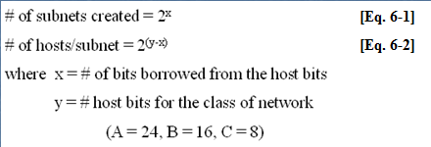
The equations for calculating the number of subnets created and the number of hosts/subnet.

Slide 128
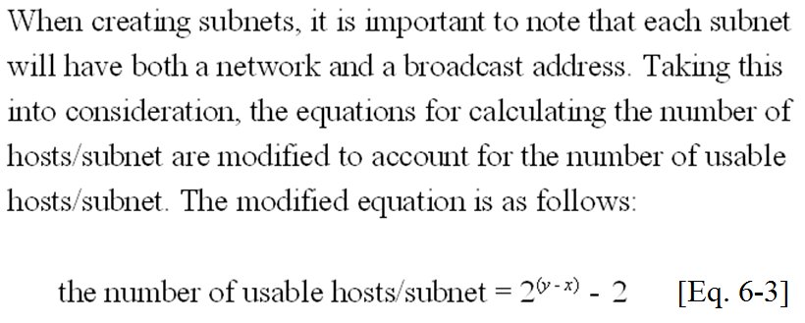

Slide 129
192.168.12.0
Network
Subnet A Subnet B Subnet C Subnet D
subnet mask = ?
Partitioning a network into subnets.

Slide 130
Network Host
24 + 2 = 26 bits 6 bits
The next step is to determine the subnet mask required for creating the four subnets. Recall that creating the four subnets required borrowing 2 host bits.
The two MSB (most significant bit) positions, borrowed from the host and network portion of the IP address must be included in the subnet mask selection.
The purpose of the subnet mask is to specify the bit positions used to identify the network and subnet bits.

Slide 131
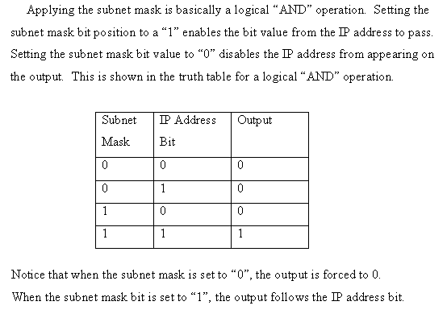

Slide 132
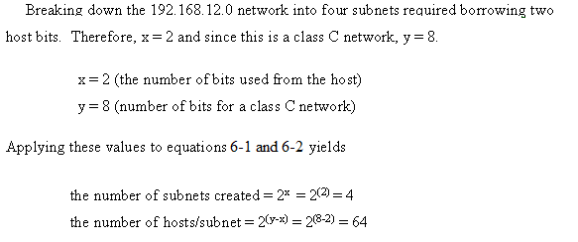
Applying equations 6-1 and 6-2 to calculate the number of subnets and hosts/subnet.

Slide 133
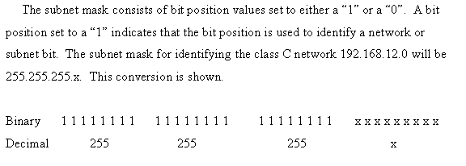
192 168 12 - - - -
Creating the subnet mask to select the 192.168.12.0 subnet.

Slide 134
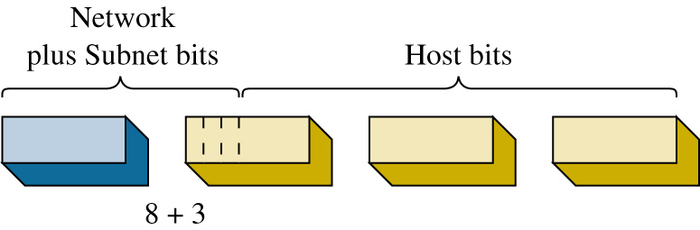

Slide 135
Network + Subnet
subnet
Network Host
Network Subnet bits Host bits
Network
Borrowed bits
Borrowing bits from the host to create subnets.

Slide 136
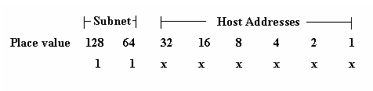

Slide 137
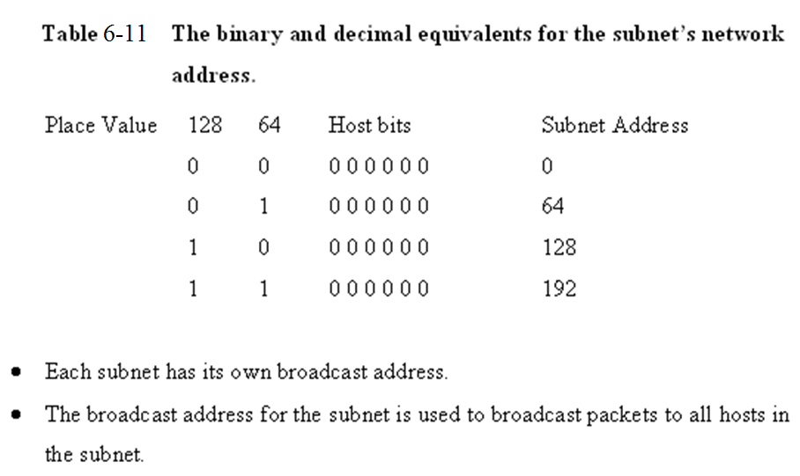

Slide 138
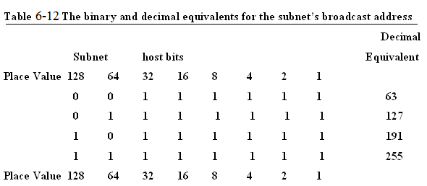

Slide 139
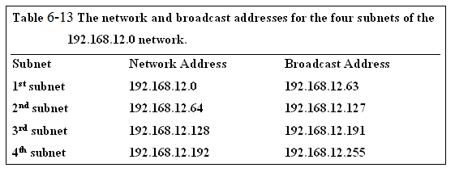

Slide 140
Example 6-8
Given a network address of 10.0.0.0, divide the network into 8 subnets. Specify the subnet mask, the broadcast addresses, and the number of usable hosts/subnet.

Slide 141
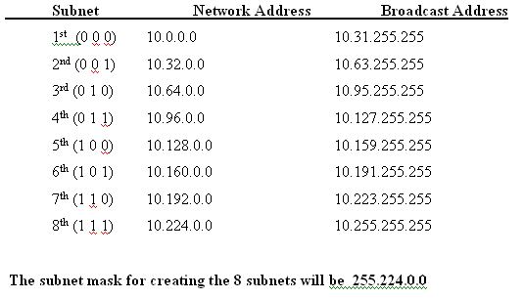


Slide 142
Network + Subnet
bits host bits
8 + 3
5 + 8 + 8

Slide 143
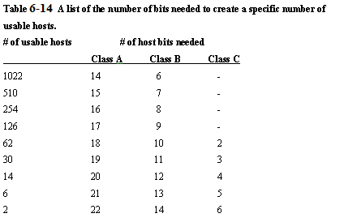

Slide 144
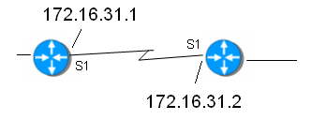
Example 6-9
Determine the subnet mask needed for the router link shown. Only two host addresses are required for this router-to-router link.

Slide 145
Example 6-9
Determine the subnet mask needed for the router link shown. Only two host addresses are required for this router-to-router link.
Answer: 255.255.255.252

Slide 146
Subnet Mask
Computer’s use the subnet mask to control data flow within network’s.
The subnet mask is used to determine if the destination IP address is intended for a host in the same LAN or if the data packet should be sent to the gateway IP address of the LAN.
The gateway IP address is typically the physical network interface on a layer 3 switch or a router.

Slide 147
Subnet Mask
For example, assume that the IP address of the computer in the LAN is 172.16.35.3.
A subnet mask of 255.255.255.0 is being used. This means that that all data packets with an IP address between 172.16.35.0 and 172.16.35.255 stay in the LAN.
A data packet with a destination IP address of 172.16.34.15 is sent to the LAN gateway. The 255.255.255.0 subnet mask indicates that all bits in the first three octets must match each other to stay in this LAN.

Slide 148
Destination Network ?
This can be verified by “ANDing” the subnet mask with the destination address as shown.
172. 16. 35.3
255.255.255.0
172. 16. 35.0 in the same subnet as the LAN
172. 16. 34.15
255.255.255 .0
172. 16. 34. 0 not in the same subnet as the LAN

Slide 149
Summary
This section has demonstrated techniques for establishing subnets and subnet masks in computer networks.
Examples have been presented that guide the reader through the process of borrowing bits to determining the number of available hosts in the subnet.

Slide 150
Section 6-5 Key Terms
Subnet Mask

Slide 151
Chapter 6-6
CIDR Blocks

Slide 152
CIDR Blocks
Up to this point, this chapter has focused on the issues of “classful” networks. Classful means that the IP addresses and subnets are within the same network.
The problem with classful addressing is there is a lot of unused IP address space. For example, a class A IP network has over 16 million possible host addresses.
A class B network has over 65,000 host addresses. The fact is only a limited number of class A and B address space has been allocated for Internet use.

Slide 153
Supernetting
A technique called supernetting was proposed in 1992 to eliminate the class boundaries and to make available the unused IP address space.
Supernetting allows multiple networks to be specified by one subnet mask. In other words, the class boundary could be overcome.

Slide 154
CIDR Notation
Supernetting required a simpler way to indicate the subnet mask. The technique developed is called CIDR – Classless InterDomain Routing. CIDR (pronounced cider) notation specifies the number of bits set to a 1 that make up the subnet mask.
For example, the class C size subnet mask 255.255.255.0 is listed in CIDR notation as /24. This indicates the 24 bits are set to a “1”.
A class B size subnet is written as /16 and a class A subnet is written as /8.

Slide 155
CIDR Notation
The CIDR can also be used to represent subnets that only identify part of the octet bits in an IP address.
For example, a subnet mask of 255.255.192.0 is written in CIDR as /18. The /18 comes from the 18 bits that are set to a 1 as shown.
255 255 192 0
1 1 1 1 1 1 1 1 1 1 1 1 1 1 1 1 1 1 1 0 0 0 0 0 0 0 0 0 0 0 0 0

Slide 156
CIDR Question
How will the network address and the subnet mask of
192.168.12.0 255.255.252.0
appear in CIDR notation?

Slide 157
CIDR Question
128 + 64 +32 + 16 + 8 + 4 = 252
1 1 1 1 1 1 0 0

Slide 158
CIDR Question
128 + 64 +32 + 16 + 8 + 4 = 252
1 1 1 1 1 1 0 0
255 + 255 + 252
8 + 8 + 6
/22

Slide 159
Answer
A network address and the subnet mask of
192.168.12.0 255.255.252.0
can be written in CIDR notation as
192.168.12.0 / 22.

Slide 160
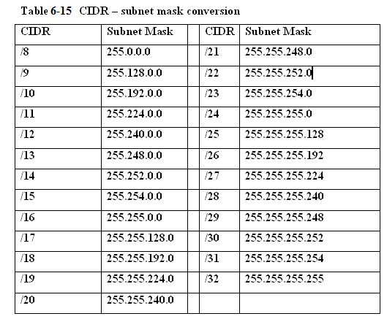
Table 5-15 CIDR – subnet mask conversion

Slide 161
Supernets
CIDR Blocks are used to break down the class barriers in IP addressing. For example, two class C networks
[192.168.78.0/24 and 192.168.79.0/24]
can be grouped together as one big subnet. These two class C networks can be grouped together by modifying the /24 CIDR number to /23.
This means that one bit has been borrowed from the network address bits to combine the two networks into one supernet.

Slide 162
Supernets
Writing these two networks in CIDR notation provides 192.168.78.0 / 23
This reduces the two class C subnets to one larger network. The group of networks defined by CIDR notation is called a CIDR Block.
When you group two or more classful networks together they are called supernets.

Slide 163
Example 6-10
Explore what happens if the boundary in IP
addresses for class C subnets is crossed. For this
example, the subnets have IP addresses of:
192.168.78.0 / 22
192.168.79.0 / 22
192.168.80.0 / 22
192.168.81.0 / 22

Slide 164
Example 6-10 Solution
Apply the /22 subnet mask to
192.168.78.0 and 192.168.80.0
provides the following.
Place Value 128 64 32 16 8 4 2 1
192. 168. 78. 0 IP 0 1 0 0 1 1 1 0
255. 255.252. 0 SM 1 1 1 1 1 1 0 0
192. 168. 76. 0 0 1 0 0 1 1 0 0 (76)
64 + 8 + 4 = 76

Slide 165
Example 6-10 Solution
Now the same subnet mask is applied to the
192.168.80.0 subnet.
Place Value 128 64 32 16 8 4 2 1
192. 168. 80. 0 IP 0 1 0 1 0 0 0 0
255. 255.252. 0 SM 1 1 1 1 1 1 0 0
192. 168. 80. 0 0 1 0 1 0 0 0 0 (80)
64 + 16 = 80

Slide 166
Boundary Lines
Applying the /22 subnet mask places these two IP addresses in different subnets.
The first IP address is placed in the “76” subnet while the second IP address is placed in the “80” subnet”.
The boundary line has been crossed placing the IP addresses in different subnets when the /22 is applied.

Slide 167
Crossing Boundaries
This example shows what will happen if a boundary is crossed in IP addressing.
If four class C subnets need to be grouped into one CIDR block then IP addresses from the ranges shown could be used.
192.168.76.0 to 192.168.79.0
(all will be in the “76” subnet)
192.168.80.0 to 192.168.83.0
(all will be in the “80” subnet)
Careful planning is required to make sure the IP addresses can all be specified by the same subnet mask.

Slide 168
Section 6-6 Key Terms
Classful
Supernetting
CIDR
CIDR Block
Supernets

Slide 169
Chapter 6-7
IPv6 Addressing

Slide 170
IPv6
IP version 6 (IPv6) is the proposed solution for expanding the possible number of users on the Internet. IPv6 is also called IPng, the next generation IP.
IPv6 uses a 128-bit address technique as compared to IPv4’s 32-bit address structure.
IPv6 provides for a large number of IP addresses (2¹²⁸).

Slide 171
IPv6
IPv6 numbers are written in hexadecimal rather than dotted decimal. For example, the following is a 32 hexadecimal digit IPv6 address. (Note: 32 hex digits x 4 bits/hex digit = 128 bits)
6789:ABCD:1234:EF98:7654:321F:EDCB:AF21
This is classified as a full IPv6 address. The “full” means that all 32 hexadecimal positions contain a value other than 0.

Slide 172
IPv6
IPv6 uses 7 colons (:) as separators to group the 32 hex characters into 8 groups of four.
Some IPv6 numbers will have a 0 within the address. In this case, IPv6 allows the number to be compressed to make it easier to write the number.
For example, assume that an IPv6 number is as follows:
6789:0000:0000:EF98:7654:321F:EDCB:AF21

Slide 173
IPv6 [double-colon]
Consecutive 0’s can be dropped and a double-colon notation can be used as follows:
6789:0000:0000:EF98:7654:321F:EDCB:AF21
6789::EF98:7654:321F:EDCB:AF21

Slide 174
IPv6 [double-colon]
Recovering the compressed number in double-colon notation simply requires that all numbers left of the double notation be entered beginning with the left most slot of the IPv6 address.
Next, start with the numbers on right of the double-colon. Begin with the right most slot of the IPv6 address slots and enter the numbers from right to left until the double-colon is reached. Zeros are entered into any empty slots.
6789::EF98:7654:321F:EDCB:AF21
6789 : 0 : 0 :EF98 :7654 :321F :EDCB :AF21

Slide 175
IPv6
IPv4 numbers can be written in the new IPv6 form by writing the IPv4 number in hexadecimal and placing the number to the right of a double-colon.
Example 6-11 demonstrates how a dotted-decimal IP number can be converted to IPv6 hexadecimal.

Slide 176
Example 6-11
Problem: Convert the IPv4 address of 192.168.5.20 to an IPv6
hexadecimal address.
Solution: First convert each dotted-decimal number to hexadecimal.
Decimal Hex
192 C0
168 A8
5 05
20 14
(Hint: use a calculator or a lookup table to convert the decimal numbers to hexadecimal.)

Slide 177
Example 6-11
The IPv6 address will have many leading 0’s, therefore the IPv6 hex address can be written in double-colon notation as:
:: C0A8:0514

Slide 178
Example 6-11
IPv4 numbers can also be written in IPv6 form by writing the IPv4 number in dotted-decimal format as shown.
Note that the number is preceded by 24 hexadecimal 0’s.
0000: 0000: 0000: 0000: 0000: 0000:192.168.5.20
This number can be reduced as follows:
::192.168.5.20

Slide 179
Types of IPv6 addresses
There are three types of IPv6 addresses. These are unicast, multicast, and anycast.
The unicast IPv6 address is used to identify a single network interface address and data packets are sent directly to the computer with the specified IPv6 address.
There are several types of unicast addresses including link-local addresses, global unicast addresses, and unique local addresses. Link-local addresses are designed to be used for and are limited to communications on the local link.
Every IPv6 interface will have one link-local address.

Slide 180
Types of IPv6 addresses
Multicast IPv6 addresses are defined for a group of networking devices. Data packets sent to a multicast address are sent to the entire group of networking devices such as a group of routers running the same routing protocol.
Multicast addresses all start with the prefix FF00::/8. The next group of characters in the IPv6 multicast address (the second octet) are called the scope. The scope bits are used to identify which ISP should carry the data traffic.

Slide 181
Types of IPv6 addresses
The anycast IPv6 - unicast addresses are says “send to this one address” and multicast addresses are used to send the data packets “to every member of this group”,
Anycast addresses says “send to any one member of this group”. In choosing which member to send to, we would for efficiency reasons normally send to the closest one—closest in routing terms.
So we can normally also consider anycast to mean
“send to the closest member of this group”.

Slide 182
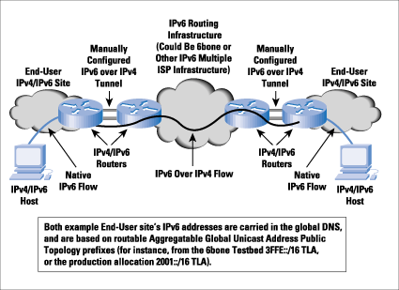
IPv6-over-IPv4 tunneling
Source: Cisco Systems
This is a technique for encapsulating IPv6 packets within the IPv4 format so the packets can be carried over the IPv4 network.

Slide 183
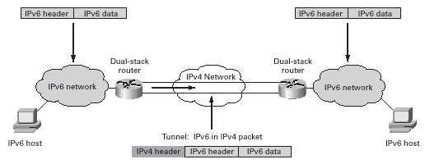
IPv6-over-IPv4 tunneling
Source: Cisco Systems
All tunneling mechanisms require that the endpoints of the tunnel run both IPv4 and IPv6 protocol stacks, that is, endpoints must run in dual-stack mode. The dual-stack routers run both IPv4 and IPv6 protocols simultaneously and thus can interoperate directly with both IPv4 and IPv6 end systems and routers.
For proper operation of the tunnel mechanisms, appropriate entries in a DNS that map between host names and IP addresses for both IPv4 and IPv6 allow the applications to choose the required address.

Slide 184
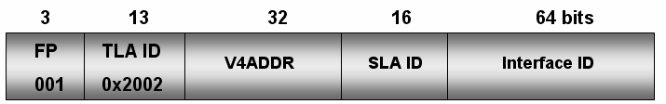
6to4 Prefix
(IPv6 over IPv4 Tunneling
The structure of the 6to4 prefix for hosts is provided. The 32 bits of the IPv4 address fit into the first 48 bits of the IPv6 address.

Slide 185
6to4 Prefix
(IPv6 over IPv4 Tunneling
FP is the Format Prefix which is made up of the higher order bits. The 001 indicates that this is a global unicast address.
TLA ID (0x2002) is the Top Level Identifiers and is issued to local Internet registries. These IDs are administered by IANA (http://www.iana.org/).
The TLA is used to identify the highest level in the routing hierarchy. The TLA ID is 13 bits long.

Slide 186
6to4 Prefix
(IPv6 over IPv4 Tunneling
V4ADDR is the IPv4 address of the 6to4 endpoint and is 32 bits long.
SLA ID is the Site Level Aggregation Identifier that is used by individual organizations to identify subnets within their site. The SLA ID is 16 bits long.

Slide 187
6to4 Prefix
(IPv6 over IPv4 Tunneling
Interface ID is the Link Level Host Identifier is used to indicate an interface on a specific subnet. The interface ID is equivalent to the host IP address in IPv4.

Slide 188
SLACC
Stateless address autoconfiguration (SLAAC) is another important feature of IPv6.
This feature allows for a server-less basic network configuration of the IPv6 computers.
With IPv4, a computer generally obtains its network settings from a DHCP server.
With IPv6, a computer can automatically configure its network settings without a DHCP server by sending a solicitation message to its IPv6 router.

Slide 189
IPv6 Transition
When will the Internet switch to IPv6?
The answer is not clear but the networking community recognizes that something must be done to address the limited availability of IP current address space.
Many manufacturers have already incorporated IPv6 capabilities in their routers and operating systems.
What about IPv4? The bottom-line is the switch to IPv6 will not come without providing some way for IPv4 networks to still function.

Slide 190
Section 6-7 Key Terms
IPv6
IPng
Full IPv6 address

